Slide 1
RETAIL SALES ANALYTICS
SALES INSIGHTS TO MARKETING TEAM

Slide 2
ATLIQ STORES
OBJECTIVE - IMPACT OF PROMOTIONS ON PRODUCT SALES REVENUE
SALES PERIOD - DIWALI & SANKRANTI
ANALYSIS TYPE – BEFORE PROMOTION & AFTER PROMOTION
REGION – SOUTH INDIA
CITIES – BENGALURU, CHENNAI, HYDERABAD, MYSURU, MADURAI, MANGALORE, COIMBATORE, VIJAYWADA, VISHAKAPATNAM, TRIVANDRUM

Slide 3
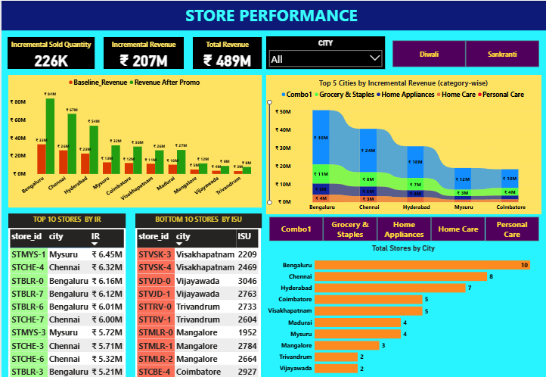

Slide 4
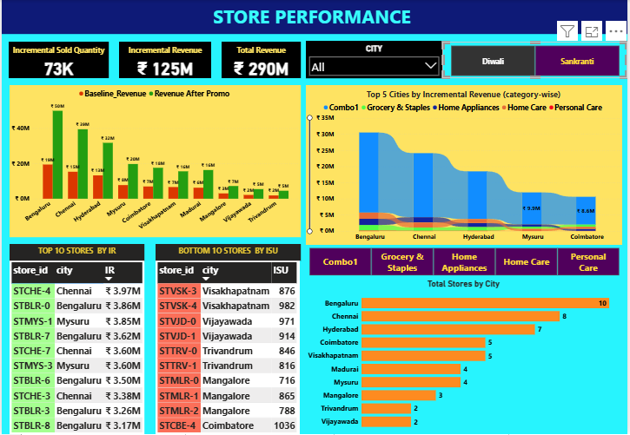

Slide 5
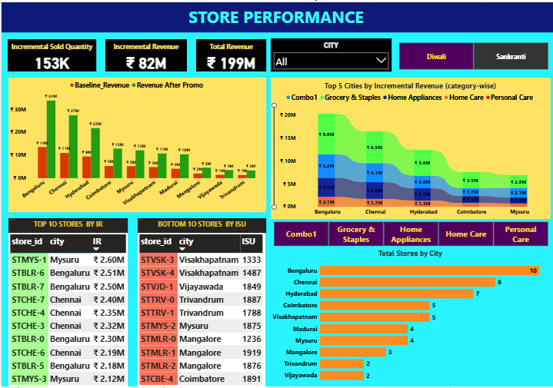

Slide 6
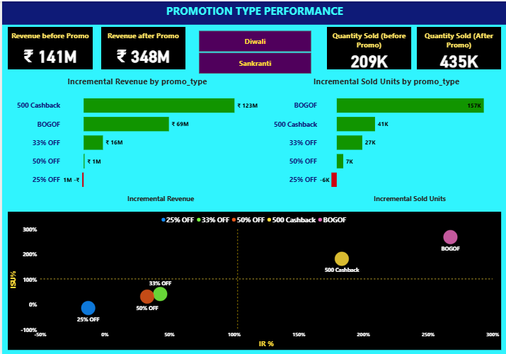

Slide 7
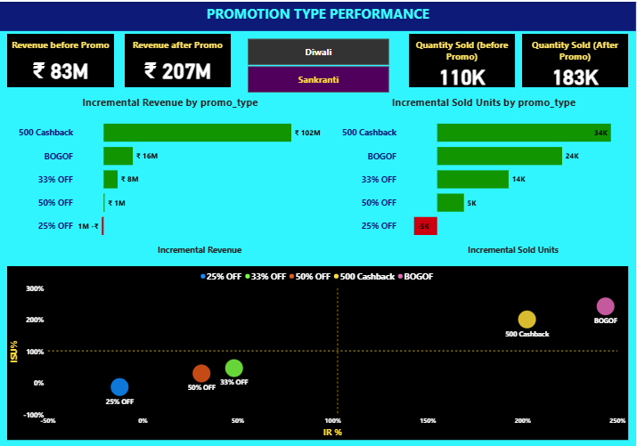

Slide 8
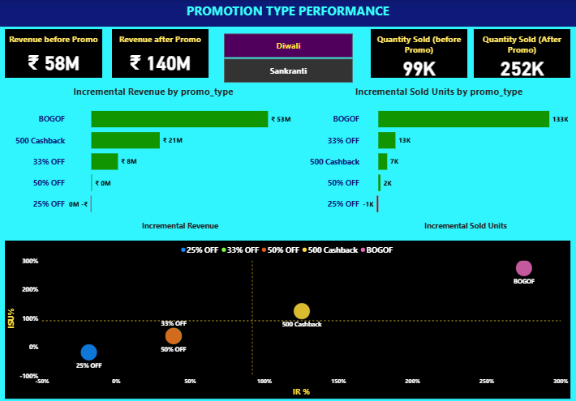

Slide 9
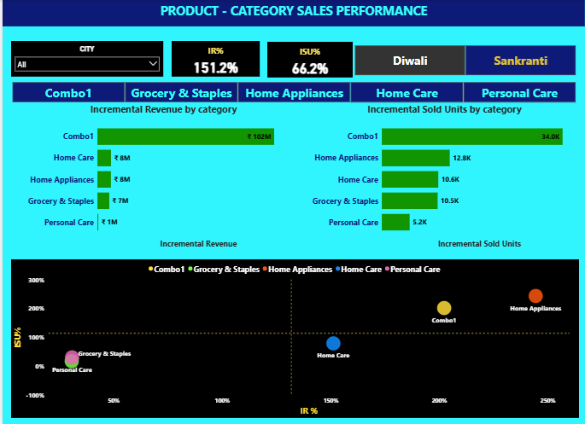

Slide 10
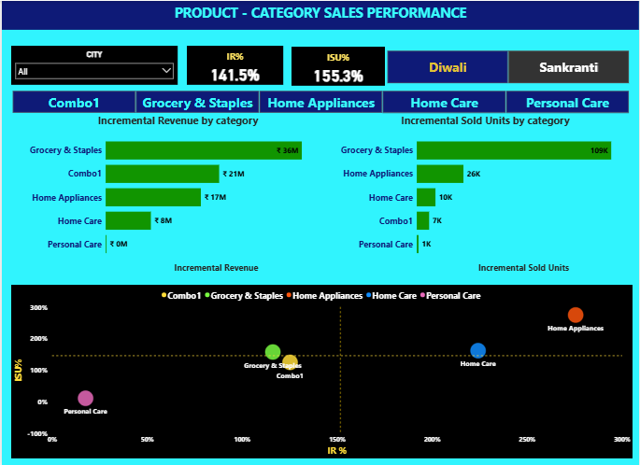

Slide 11
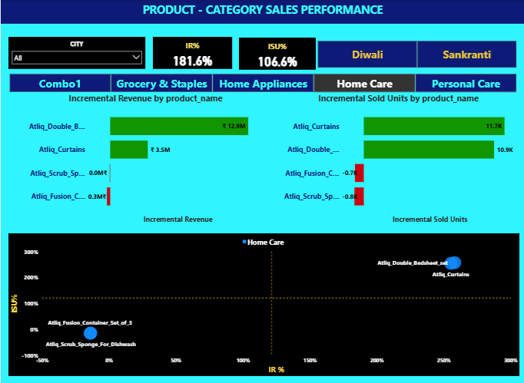

Slide 12
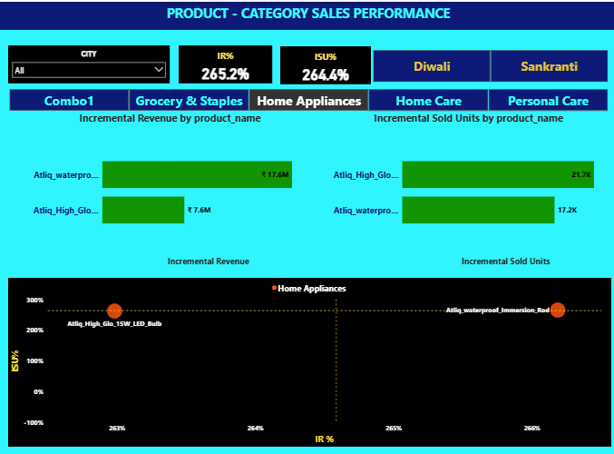

Slide 13
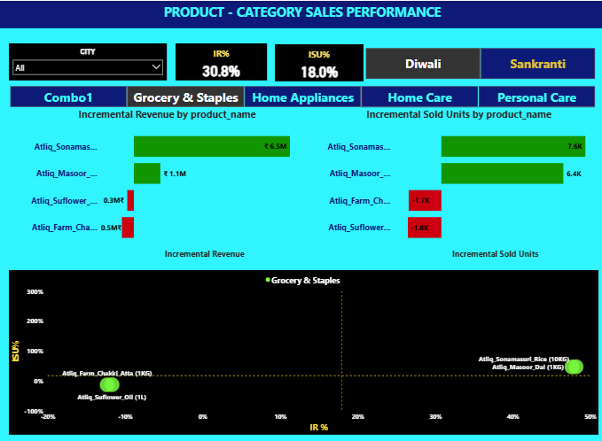

Slide 14
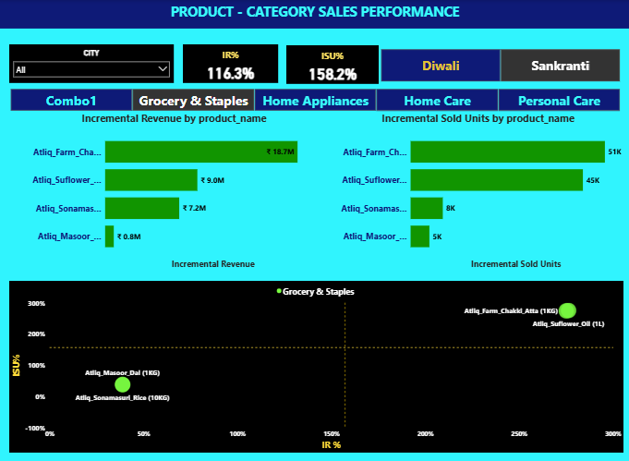

Slide 15
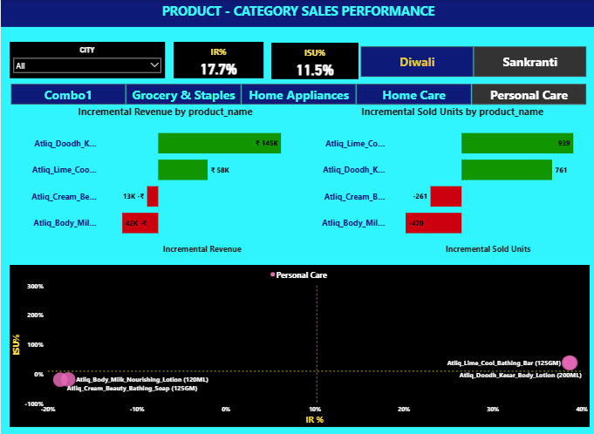

Slide 16
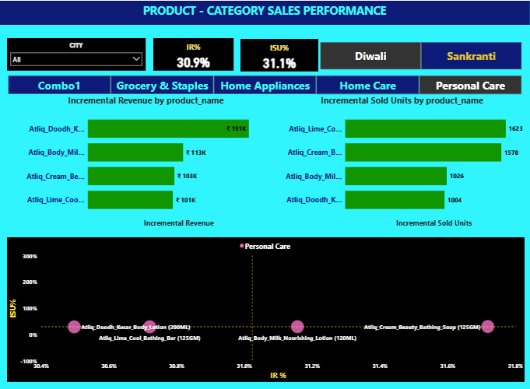

Slide 17
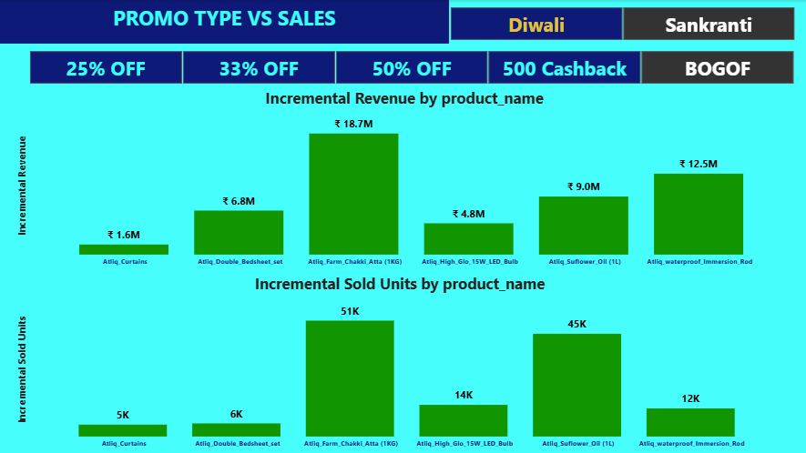

Slide 18
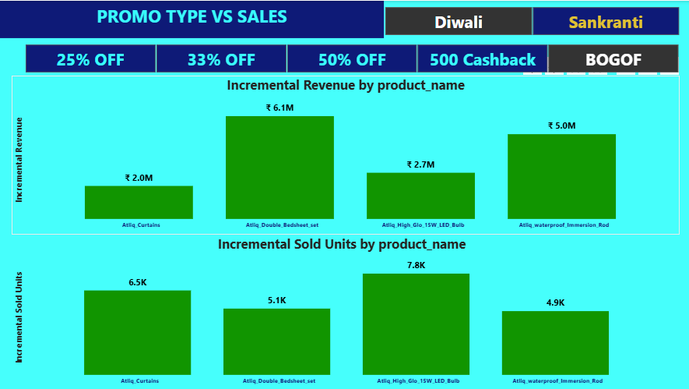

Slide 19
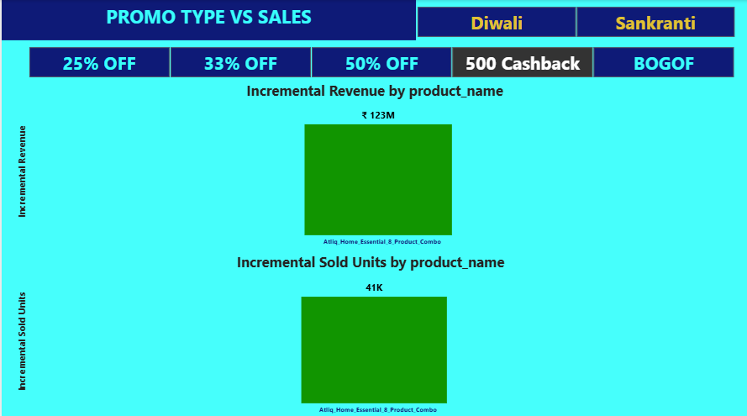

Slide 20
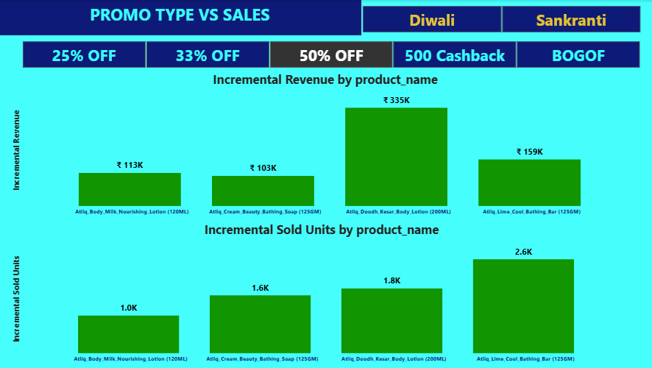

Slide 21
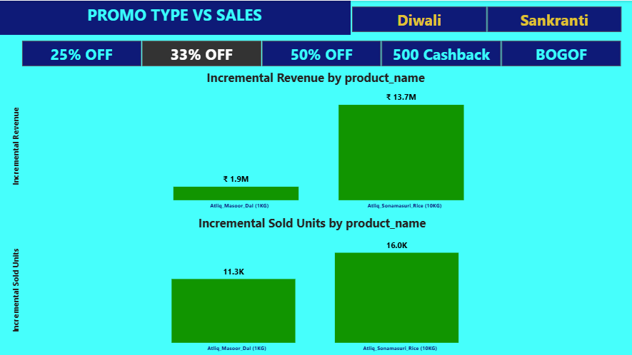

Slide 22
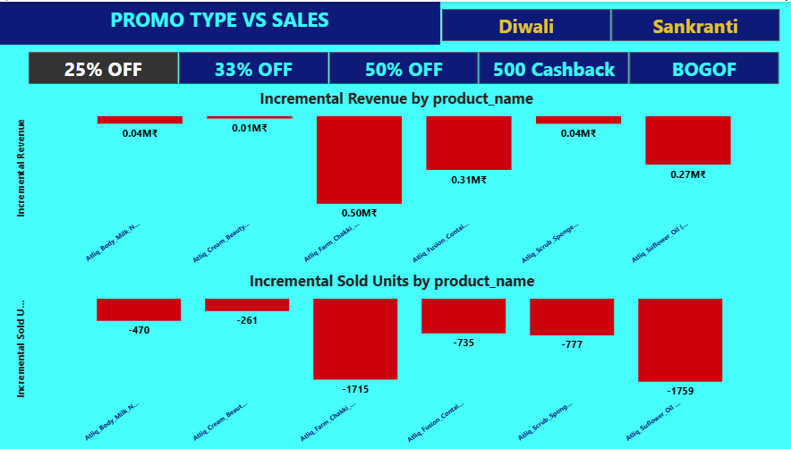

Slide 23


AD-HOC REQUESTS 1
SELECT DISTINCT
f.product_code, dp.product_name
FROM fact_events AS f
JOIN dim_products AS dp
ON dp.product_code = f.product_codewhere f.base_price > 500 AND f.promo_type = 'BOGOF';

Slide 24
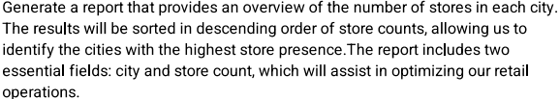
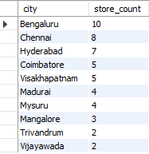
AD-HOC REQUESTS 2
SELECT DISTINCT city , COUNT(DISTINCT(store_id)) AS store_count
FROM dim_stores
GROUP BY city
ORDER BY store_count DESC ;

Slide 25
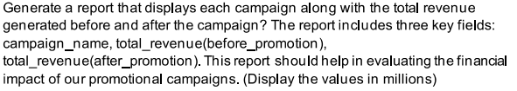
AD-HOC REQUESTS 3
SELECT dc.campaign_name,
ROUND(SUM(f.base_price * f.`quantity_sold(before_promo)`) / 1000000.0, 2) AS Total_revenue_Before_promotion_Millions,
ROUND(SUM(f.base_price * f.`quantity_sold(after_promo)`) / 1000000.0, 2) AS Total_revenue_After_promotion_Millions
FROM fact_events AS f
JOIN dim_campaigns AS dc
ON dc.campaign_id = f.campaign_id
GROUP BY f.campaign_id, dc.campaign_name;

Slide 26
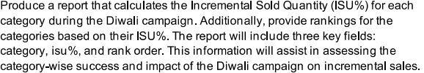
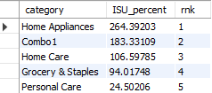
AD-HOC REQUESTS 4
WITH category_summary AS
( SELECT dp.category,
(SUM(f.`quantity_sold(after_promo)`) - SUM(f.`quantity_sold(before_promo)`)) * 100.0 / SUM(f.`quantity_sold(before_promo)`) AS ISU_percent
FROM fact_events AS f
JOIN dim_products AS dp
ON dp.product_code = f.product_code
GROUP BY dp.category)
SELECT category, ISU_percent,
DENSE_RANK() OVER (ORDER BY ISU_percent DESC) AS rnk
FROM category_summary;

Slide 27
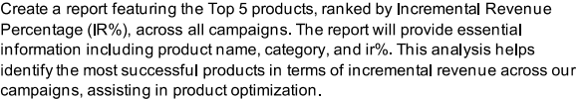
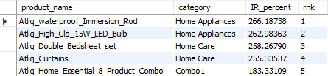
AD-HOC REQUESTS 5
WITH product_summary AS
( SELECT dp.category, dp.product_name,
(SUM(f.base_price * f.`quantity_sold(after_promo)`) - SUM(f.base_price * f.`quantity_sold(before_promo)`)) * 100.0 /
SUM(f.base_price * f.`quantity_sold(before_promo)`) AS IR_percent
FROM fact_events AS f
JOIN dim_products AS dp ON dp.product_code = f.product_code
GROUP BY dp.product_name, dp.category)
SELECT product_name, category, IR_percent,
DENSE_RANK() OVER (ORDER BY IR_percent DESC) AS rnk

